Slide 1
CS492 - Operating Systems Virtual Memory (2)
Georgios Portokalidis & Jun Xu
ZyBook 7, MOS 3.3-3.7
Slides credit: Antonio Barbalace

Slide 2
Content
Page Replacement Algorithms
Optimal
Not Recently Used
FIFO
Second-chance
Clock
Least Recently Used
Not Frequently Used
Aging
Demand paging and Prepaging
Working Set Model
WS Algorithm
WS Clock Algorithm
Page Allocation
Fixed, Priority
Local, Global
Thrashing
PFF

Slide 3
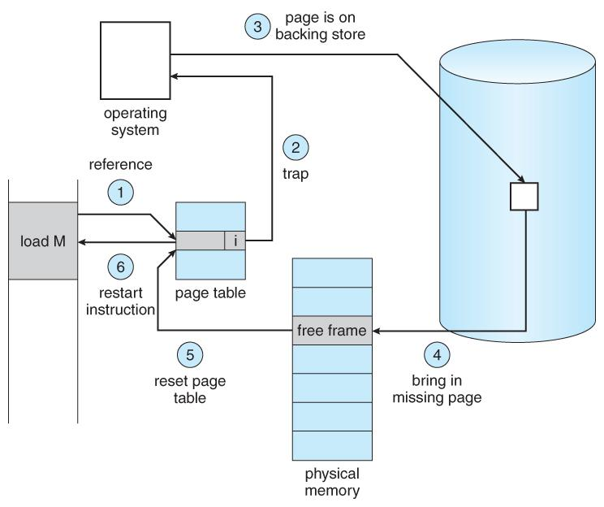
What to do if there is no free page frame in memory?
Load a new program
Program requests for more memory
Page fault
… need a free page frame
Identify some page(s) in memory, and move it disk
Which page(s) to select?

Slide 4
Page Replacement Algorithm(s)
Question
What page to evict when memory is full and a new page is demanded?
Goal
Lowest number of (future) page faults
Input of algorithm
A particular string of memory references
(page) 1, 2, 3, 4, 1, 2, 5, 1, 2, 3, 4, 5
Output of algorithm
The number of page faults on that string

Slide 5
String of Memory References
Ordered list of pages the program will reference
Example 1, 2, 3, 4, 1, 2, 5, …
MOV R0, 0x0123
MOV R1, 0x1234
MOV R2, 0x2345
MOV R3, 0x3456
MOV 0x0100, R0
MOV 0x1200, R1
MOV R4, 0x4567
0x0000
1
0x1000
2
0x2000
3
0x3000
4
0x4000
5
0x5000

Slide 6
Optimal Algorithm (OPT)
What’s the best we can possibly do?
Assume OS knows about the future
Algorithm
Replace the page that will be used furthest in the future
Estimate by
Logging page use on previous runs of process
Impractical
Depends on the application
Depends on its input

Slide 7
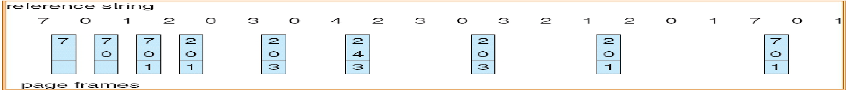

Optimal Algorithm: Example
3 physical page frames
8 virtual pages
How many page faults?
9 page faults

Slide 8
Optimal Algorithm: Infeasibility
Nice, but not achievable in real systems!
Only works if we know the whole sequence of page references
Not realizable in practice (usually)
However
May be approximated by running the program twice
Once to generate the reference trace
Once (or more) to apply the optimal algorithm

Slide 9
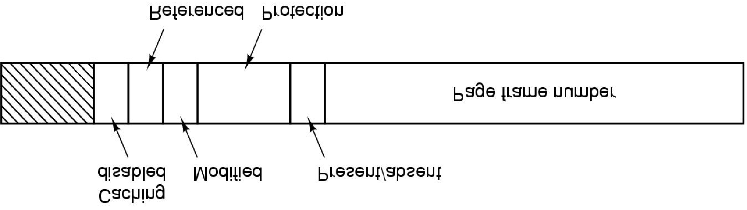

Recall: Page Table Entry
Modified, Referenced bits
Keep track of page usage, flagged by the hardware
Protection bit
What kind of access is permitted (read, write, execute)
Present/absent (valid/invalid) bit
1, entry is valid and can be used
0, page is not currently in memory
Accessing a page with absent/invalid entry causes a page fault
R is set whenever the page is referenced (read or written)
M is set when the page is written to (i.e., modified)
These bits are set by the hardware; once a bit has been set to 1, it stays 1 until the OS resets it
Notes:
If the hardware does not have these bits, they can be simulated using the operating
system’s page fault and clock interrupt mechanisms. When a process is started
up, all of its page table entries are marked as not in memory. As soon as any
page is referenced, a page fault will occur. The operating system then sets the R bit
(in its internal tables), changes the page table entry to point to the correct page,
with mode READ ONLY, and restarts the instruction. If the page is subsequently
modified, another page fault will occur, allowing the operating system to set the M
bit and change the page’s mode to READ/WRITE.

Slide 10
Not Recently Used (NRU) (1)
Idea
Use virtual memory hardware tracking bits
Determine what page was not recently accessed
Observation
It is better to remove a modified page that has not been referenced lately than a clean page that is in heavy use
A modified page may have to be updated on disk

Slide 11
Not Recently Used (NRU) (2)
Algorithm
When a process is started up, R and M bits for all its pages are set to 0 by the OS
Periodically (e.g., on each clock interrupt), the R bit is cleared
to distinguish pages that have not been referenced recently from those that have been
When a page fault occurs, the operating system inspects all the pages and divides them into four categories
Class 0: not referenced, not modified
Class 1: not referenced, modified
Class 2: referenced, not modified
Class 3: referenced, modified
The algorithm removes a page at random from the lowest-numbered non-empty class

Slide 12
Not Recently Used: Discussion
Easy to understand and efficient to implement
However, pages that are frequently referenced may be removed

Slide 13
First In First Out (FIFO)
FIFO
First in First Out
Maintain a linked list of all pages
In the order that they came into memory
A new page is added at the tail
Page at the beginning of list is removed

Slide 14
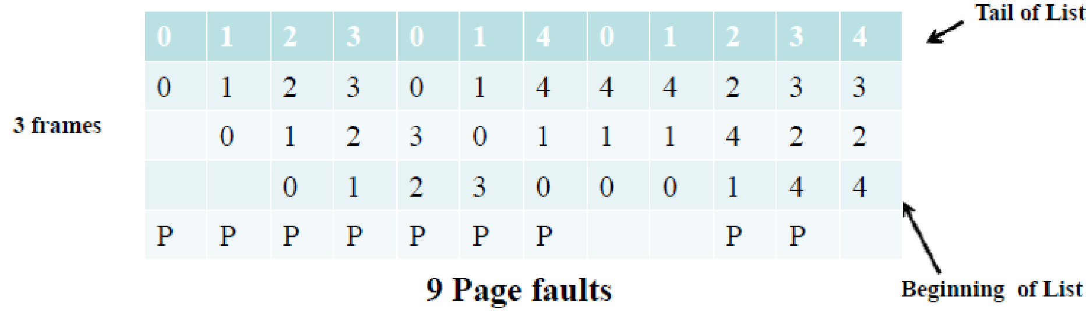
FIFO: Example
3 physical page frames
5 virtual pages
Reference string: 0, 1, 2, 3, 0, 1, 4, 0, 1, 2, 3, 4

Slide 15
FIFO: Discussion
Advantages
Trivial to implement
Disadvantages
Page in memory the longest is replaced
Does not consider the actual page usage
FIFO suffers from “Belady’s Anomaly”
The fault rate increases when there are more page frames

Slide 16
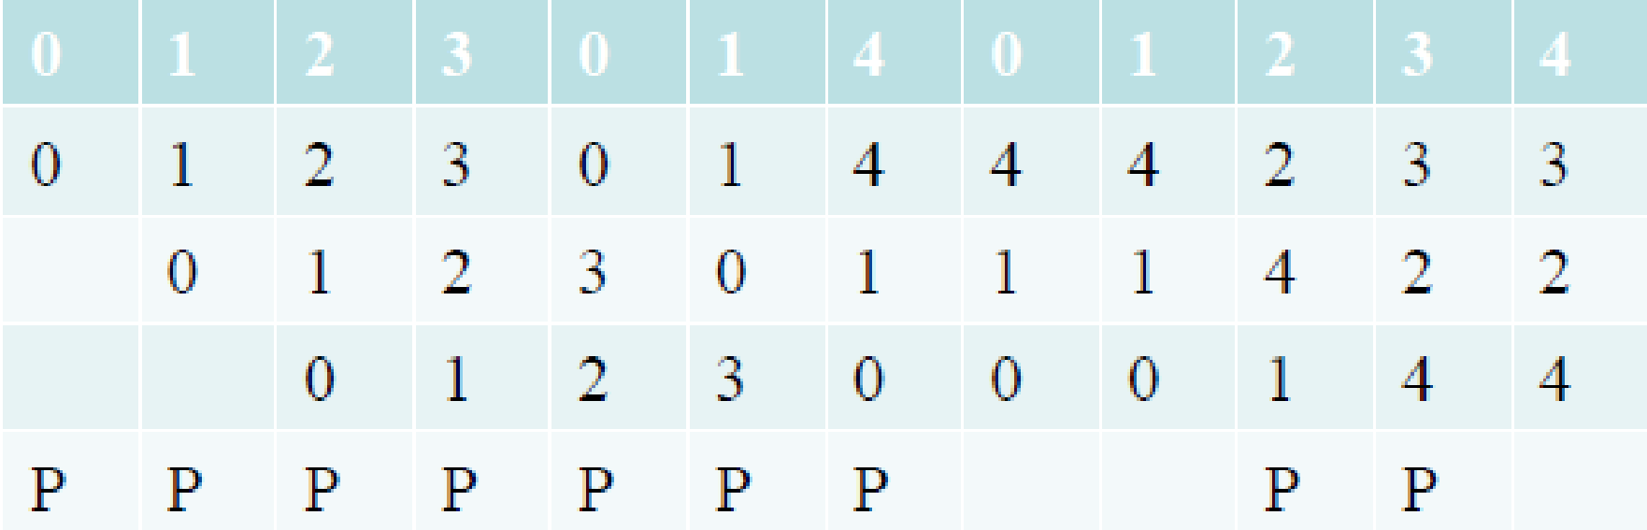
FIFO & Belady’s Anomaly (1)
Not in the book
Reference string: 0, 1, 2, 3, 0, 1, 4, 0, 1, 2, 3, 4
We have shown that there are 9 page faults for the given reference string when there are 3 page frames in memory?
3 Page Frames
How many page faults are there if now it has 4
page frames in memory?

Slide 17
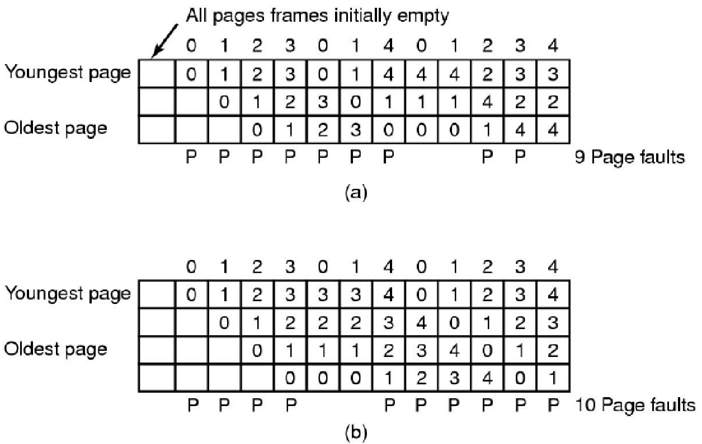
FIFO & Belady’s Anomaly (2)
Not in the book
3 page frames
4 page frames
Belady’s Anomaly: more frames → more page faults

Slide 18
Second Chance
FIFO variant
Adds the concept of usage (references)
Examine pages in FIFO order starting from beginning of list but
Consider “reference bit” R
IF R=0, remove page, go to c)
IF R=1, set R=0 and place it at the end of FIFO list (hence, the second chance), go to a)
Add new page at the end of FIFO (with R=0)
If not enough replaces on first pass, revert to pure FIFO on second pass

Slide 19
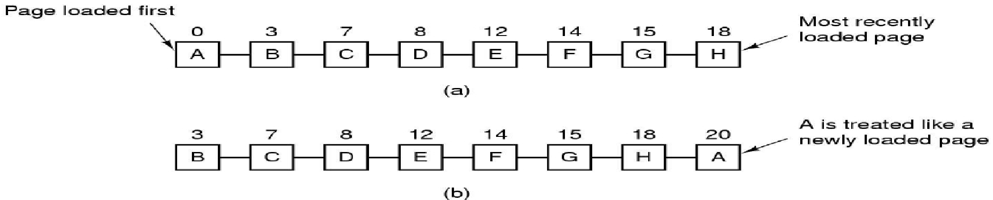
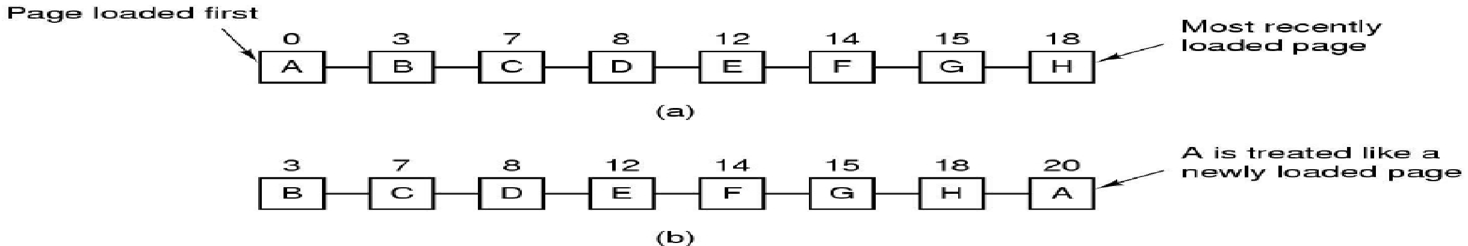
Second Chance: Example (1)
Operation of second chance. (a) Pages sorted in FIFO order. (b) Page list if a page fault occurs at time 20 and A has its R bit set. The numbers above the pages are their load times. (MOS Figure 3-15)

Slide 20
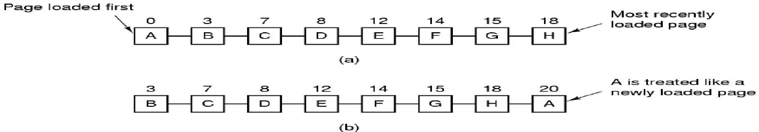



Second Chance: Example (2)
R=1
R=0
…
R=0
…
R=0
I
R=0

Slide 21
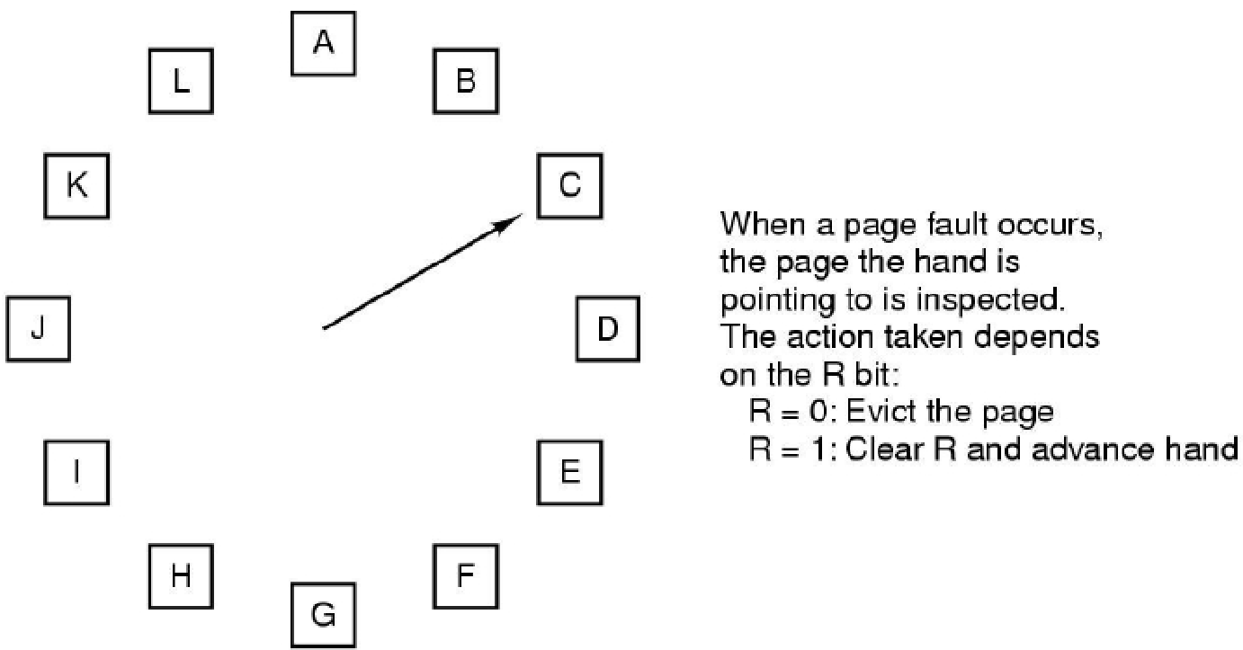
Clock
Second chance variant
Problem of the second chance mechanism
moving pages around on list is not efficient
Clock is a more performant implementation

Slide 22
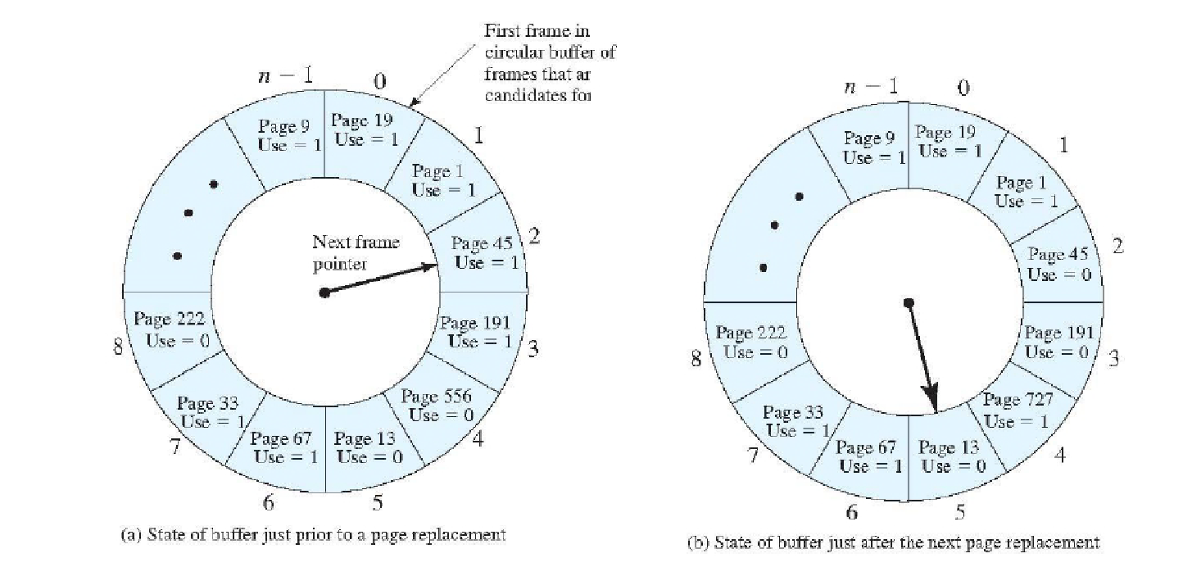
Clock: Example
“Use” = “Reference”

Slide 23
Least Recently Used (LRU)
From the Book
A good approximation of the optimal algorithm is based on the observation that
Pages that have been heavily used in the last few instructions will probably be heavily used again soon
Conversely, pages that have not been used for ages will probably remain unused for a long time
This idea suggests a realizable algorithm, LRU
When a page fault occurs, throw out the page that has been unused for the longest time

Slide 24
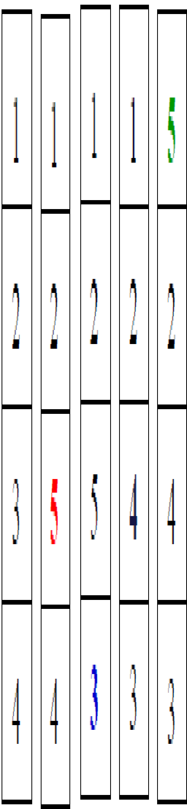
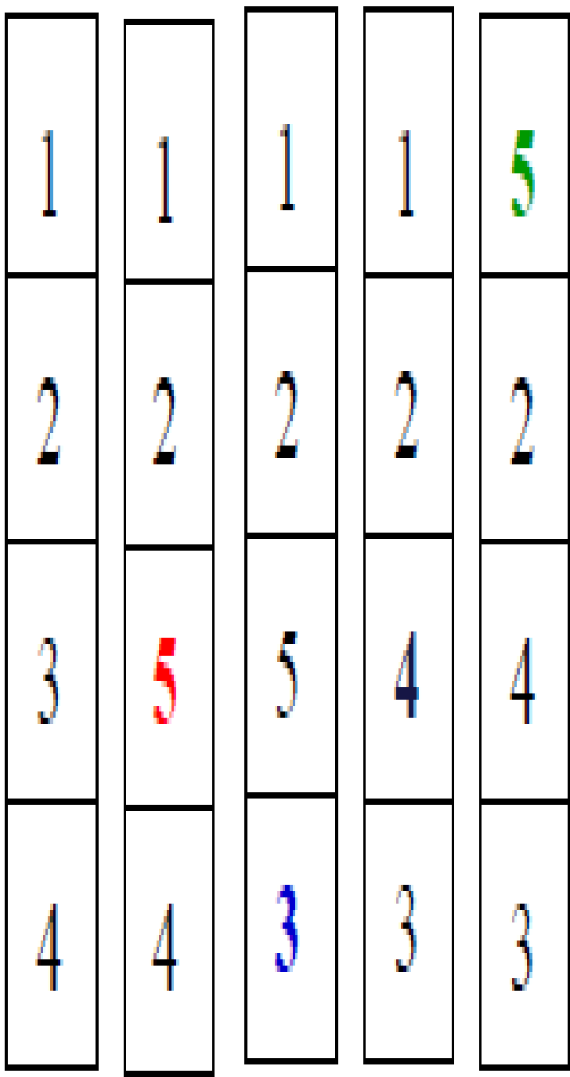
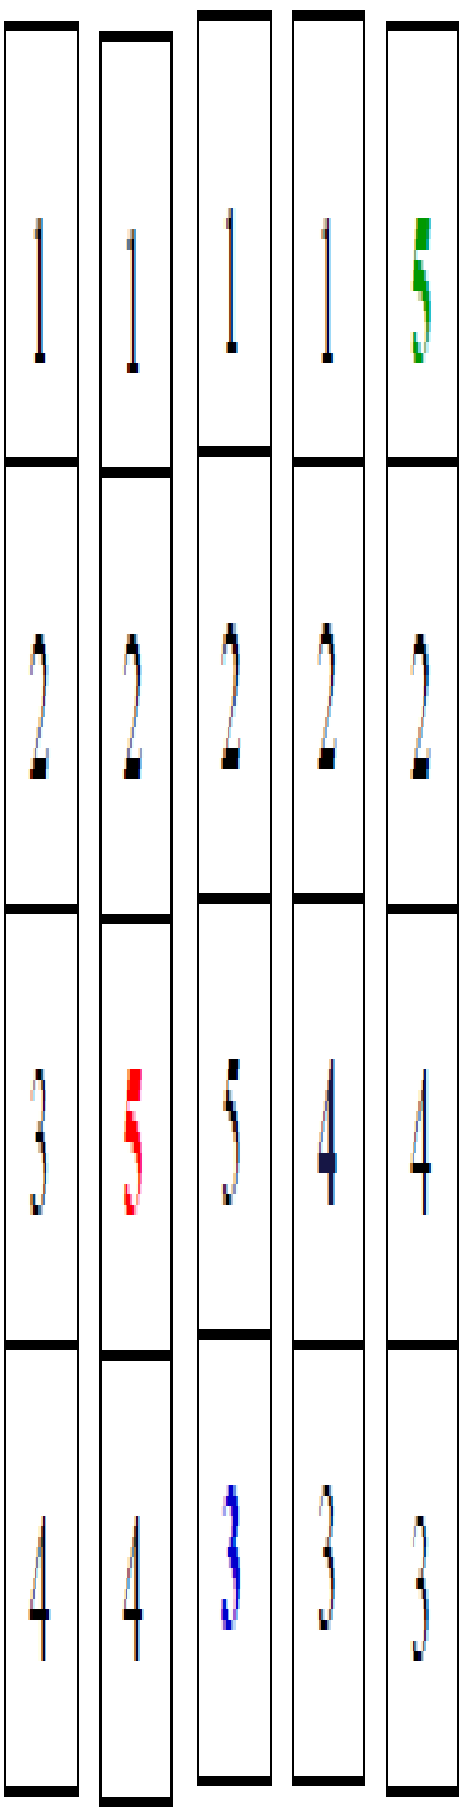
Least Recently Used: Example
Reference string: 1, 2, 3, 4, 1, 2, 5, 1, 2, 3, 4, 5
Optimal vs LRU
Optimal: Throw out pages the furthest in the future
LRU: Throw out pages the furthest in the past
1 2 3 4 1 2 5 1 2 3 4 5
P
P
P
P
P
P
P
P

Slide 25
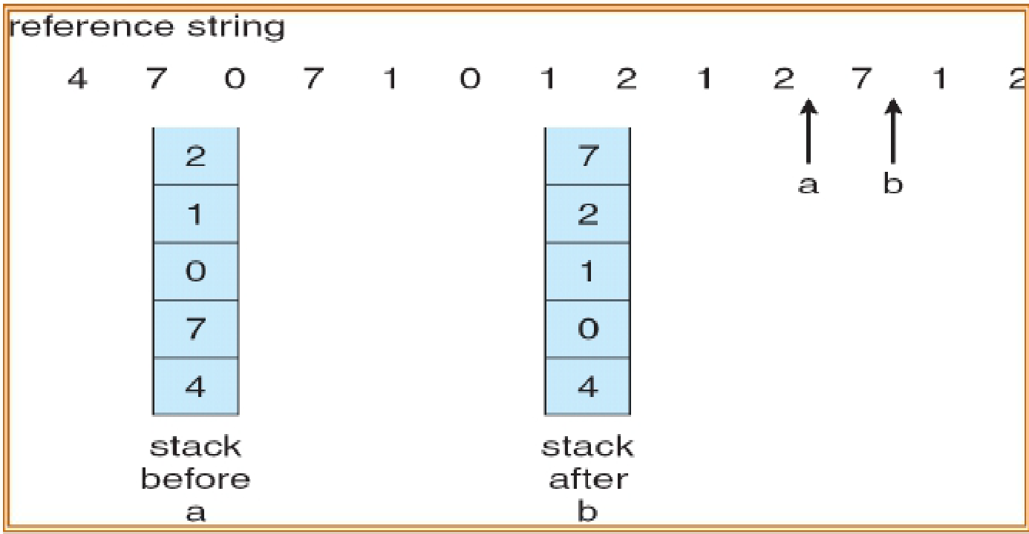
How to Implement LRU?
Priority List Solution (Heap)
Keep a double linked list of page numbers
Most recently used at front, least at rear
Always remove the page at rear
Referenced page is moved to the front
List
List

Slide 26
Implementing LRU using List
Update this list at every memory reference
Update includes
find a page in the list, move it at front
Time consuming
Can we find a more efficient implementation?

Slide 27
Implementing LRU using Counter
Counter implementation
Equip the hardware with an N-bit counter
At every instruction that references memory, increment the counter
Every page table entry must have a field to save the counter
When a page is referenced copy the counter to that field
The more recent the page is used, the larger the counter value is
For replacement, evict page with the lowest counter value (i.e., the oldest page)

Slide 28
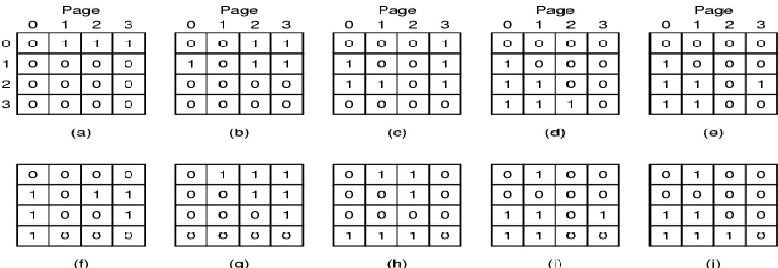
Implementing LRU using Matrix
Not in the book
Matrix implementation – n pages, a matrix of n × n bits
Initially all bits are 0
When page k is referenced
All the bits of row k are set to 1 (increase the binary value of page k)
All the bits of column k are set to 0 (decrease the binary value of other pages)
Page replacement: replace page k, if row k corresponds to lowest binary value
pages referenced in order 0,1,2,3,2,1,0,3,2,3

Slide 29
Not Frequently Used (NFU)
An implementation of LRU
Most machines do not have the hardware to perform true LRU, but it may be simulated
Algorithm
At each clock interrupt, for each page, the R bit (valued 0 or 1) is added to its software counter
Page with the lowest R-bit is evicted
What is the problem with this type of history keeping?
Never forgets (elephant)

Slide 30
Aging
An N-bit counter per page
Periodically
Shift counter to the right
Reduce counter values over time by dividing it by two
Add R to the leftmost bit
Recent R bit is added as most significant bit, therefore more weight given to more recent references!
Page replacement
Replace page with the lowest counter

Slide 31
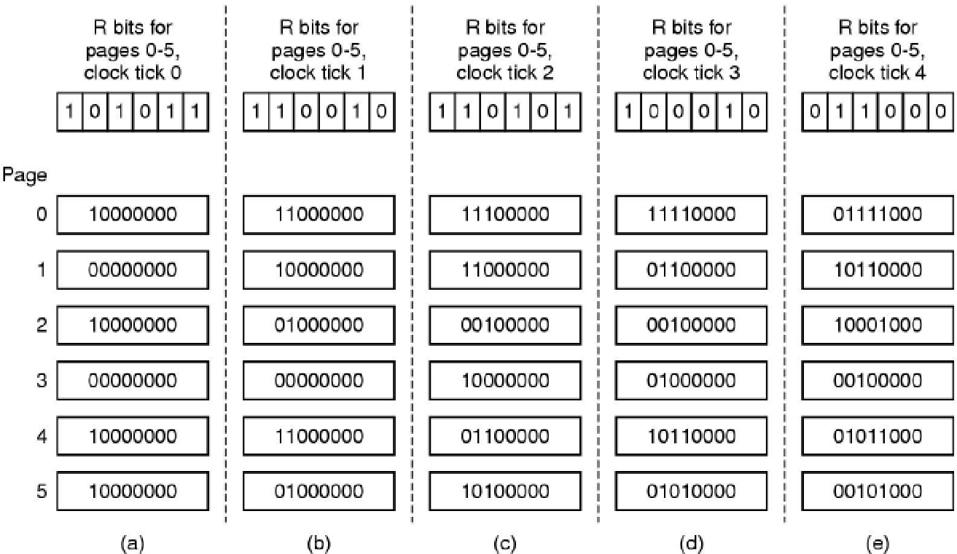
Aging: Example
The aging algorithm simulates LRU in software. Shown are six pages for five clock ticks. The five clock ticks are represented by (a) to (e). (MOS Figure 3-17)

Slide 32
Aging: Example
The aging algorithm simulates LRU in software. Shown are six pages for five clock ticks. The five clock ticks are represented by (a) to (e). (MOS Figure 3-17)

Slide 33
Question
A small computer on a smart card has four page frames. At the first clock tick, the R bits are 0111 (page 0 is 0, the rest are 1). At subsequent clock ticks, the values are 1011, 1010, 1101, 0010, 1010, 1100, and 0001. If the aging algorithm is used with an 8-bit counter, give the values of the four counters after the last tick

Slide 34
Demand Paging vs Prepaging and Working Set Model

Slide 35
When to Move Pages into Memory?
Action also called fetching
Main techniques
Demand paging
Pages are loaded on demand, not in advance
Prepaging
Load group of pages at once
Demand paging and prepaging may be used together

Slide 36
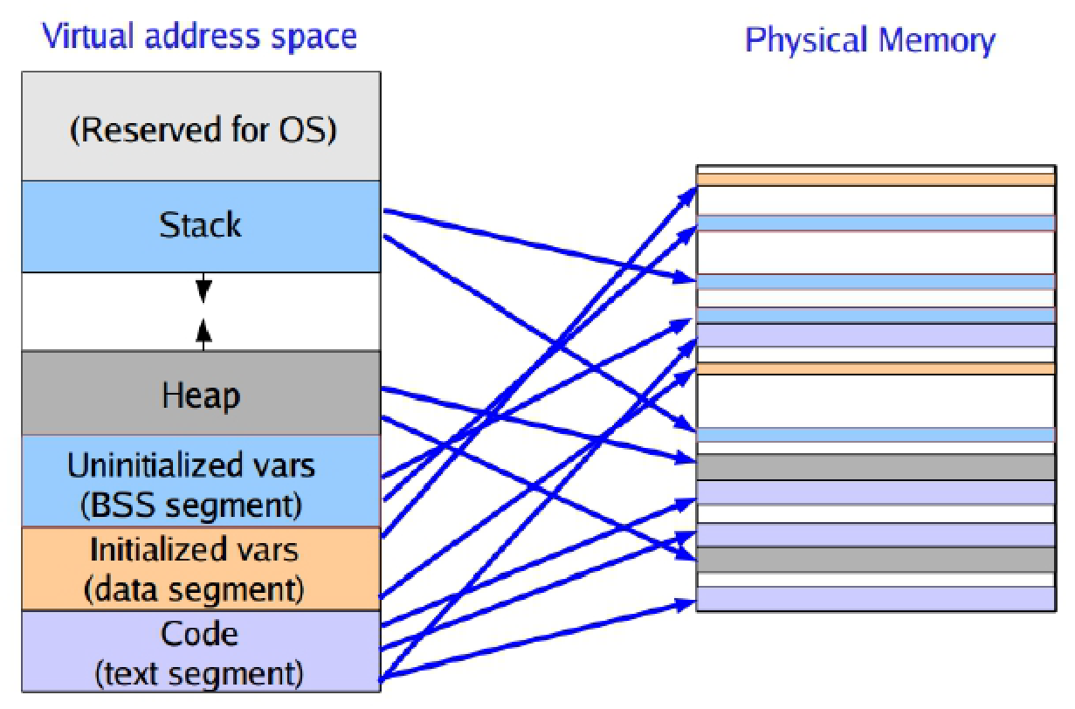
Demand Paging
No need to read an entire program in memory at once
Only a small portion of a program's code may be used!
For example, if you never use the “save as PDF” feature in OpenOffice...

Slide 37
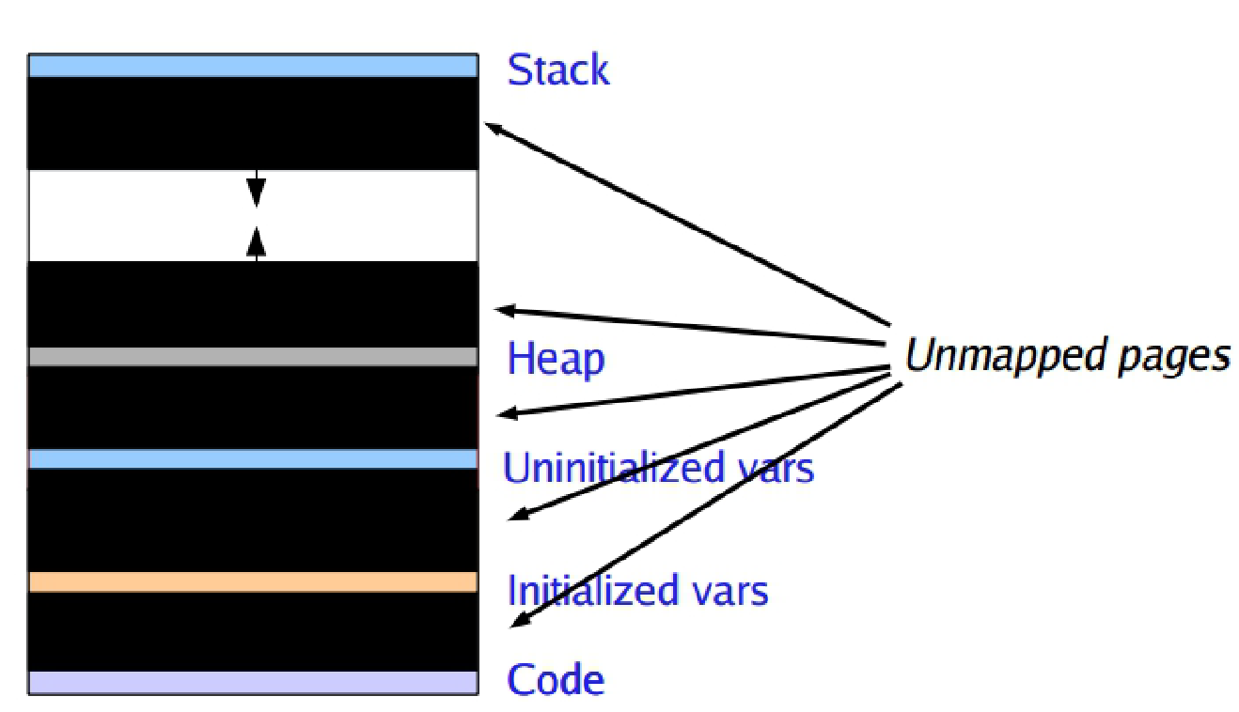
Starting up a process
What does a process's address space look like when it first starts up?

Slide 38
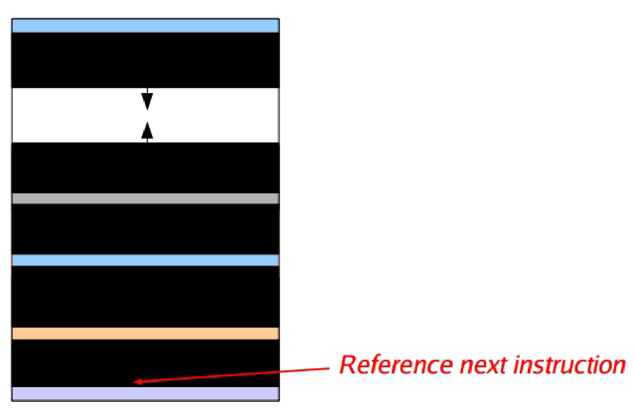
Starting up a process
What does a process's address space look like when it first starts up?

Slide 39
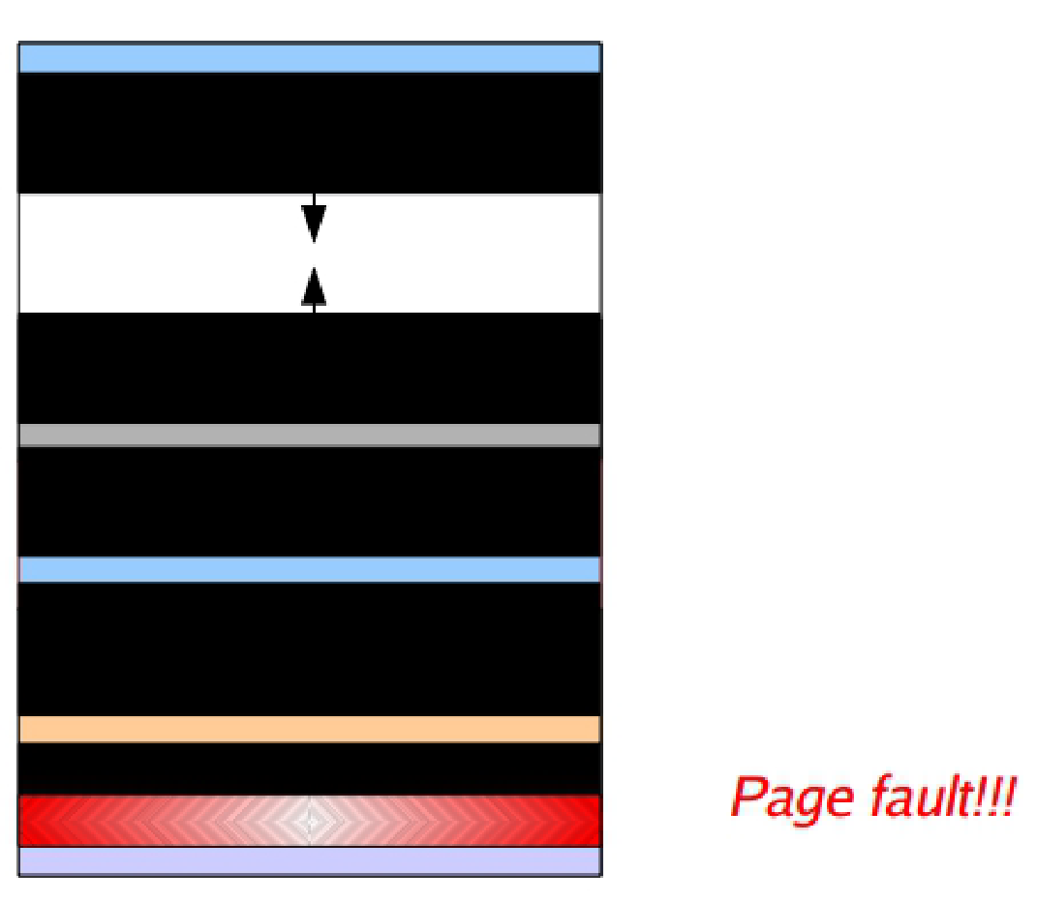
Starting up a process
What does a process's address space look like when it first starts up?

Slide 40
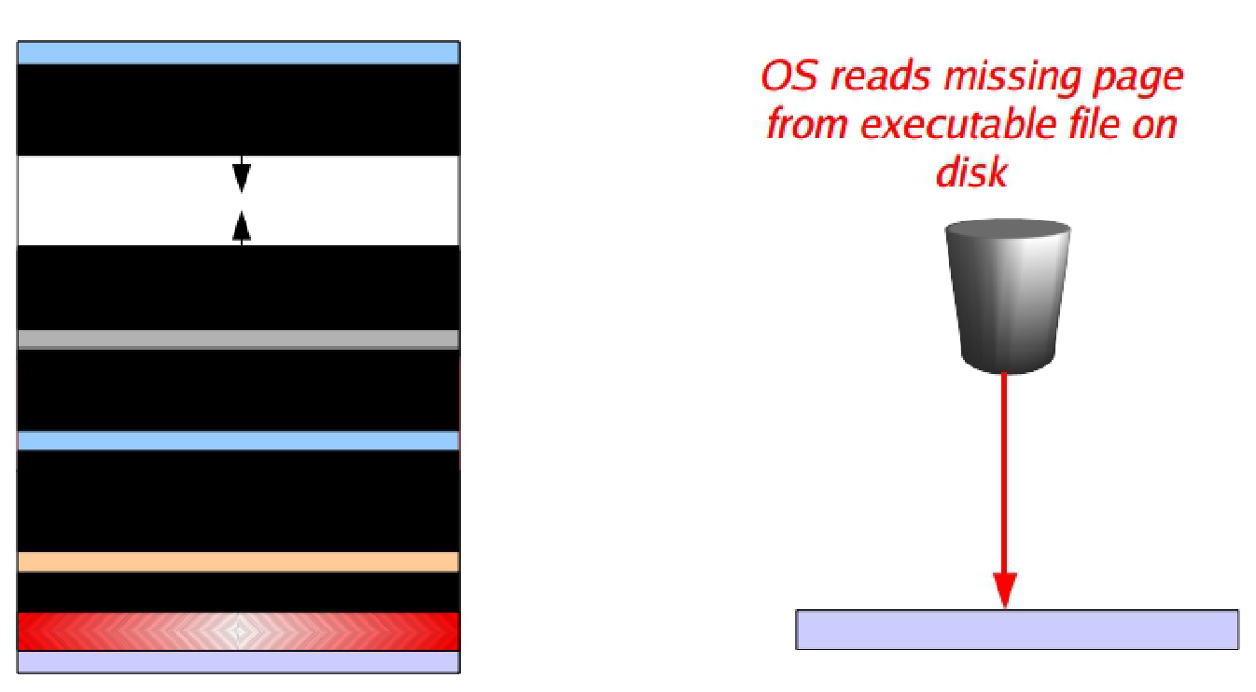
Starting up a process
What does a process's address space look like when it first starts up?
Demand Paging

Slide 41
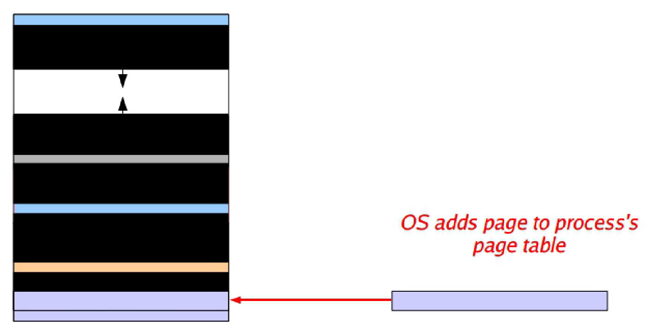
Starting up a process
What does a process's address space look like when it first starts up?
Demand Paging

Slide 42
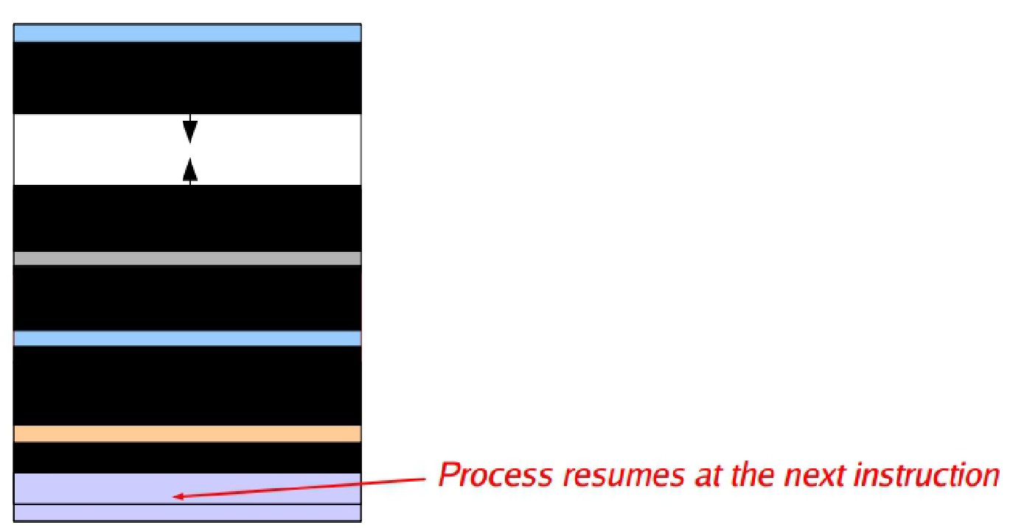
Starting up a process
What does a process's address space look like when it first starts up?
Demand Paging

Slide 43
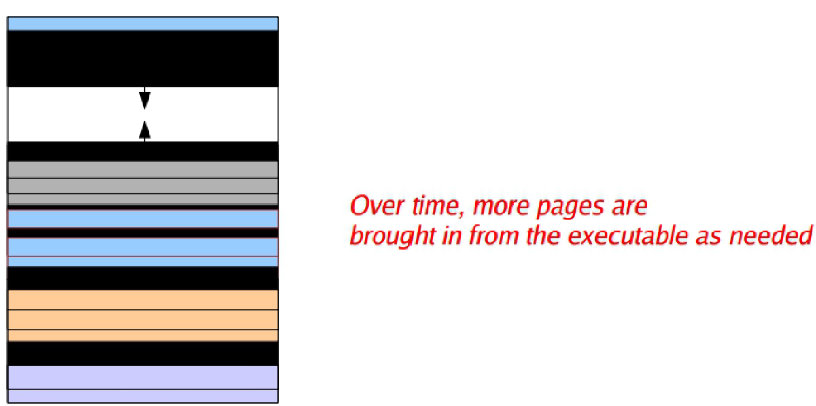
Starting up a process
What does a process's address space look like when it first starts up?
Demand Paging

Slide 44
Prepaging
Load a group of pages at once
What group of pages?
Examples
All program pages
The first/last/* N pages
Working set pages

Slide 45
Working Set Model (1)
Working Set
A set of pages that a process is currently using
May change over time by
Pages
Size
Notes:
“pages” means what pages
Size means the total size

Slide 46
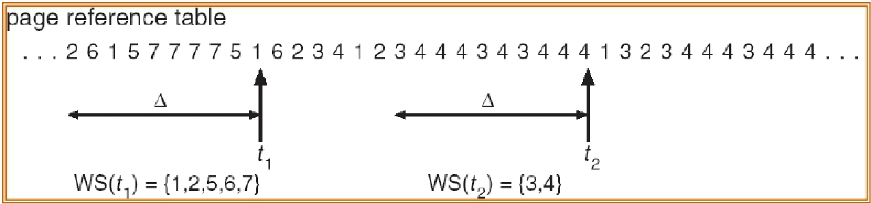
Working Set Model (2)
k
k
w(k, t₁)={1,2,5,6,7}
w(k, t₂)={3,4}
w
Examples of working set for k = 10
Working set is the set of pages used by
the k most recent memory references
w(k,t) is the size of the working set at time t

Slide 47
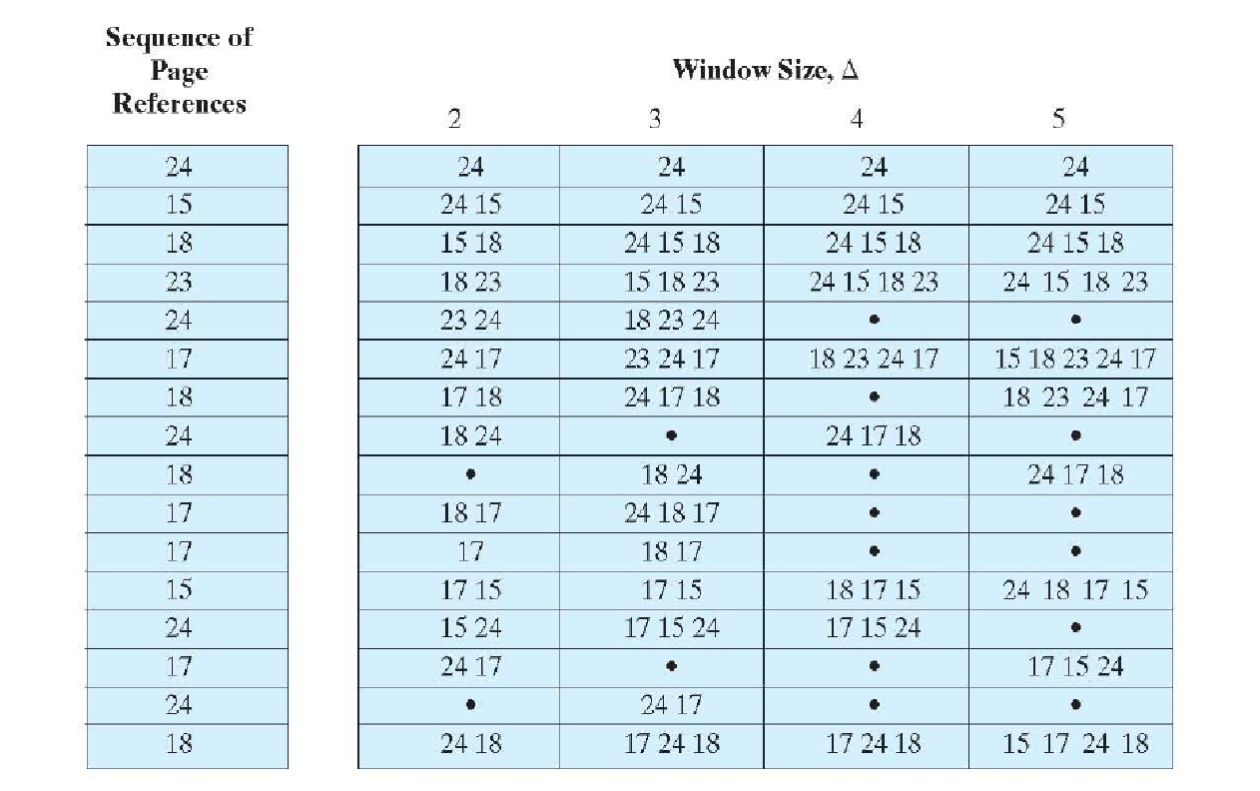
Working Set as Defined by Window Size
k
Notes:
This is just about the previous function w( … ) not about the algorithm

Slide 48
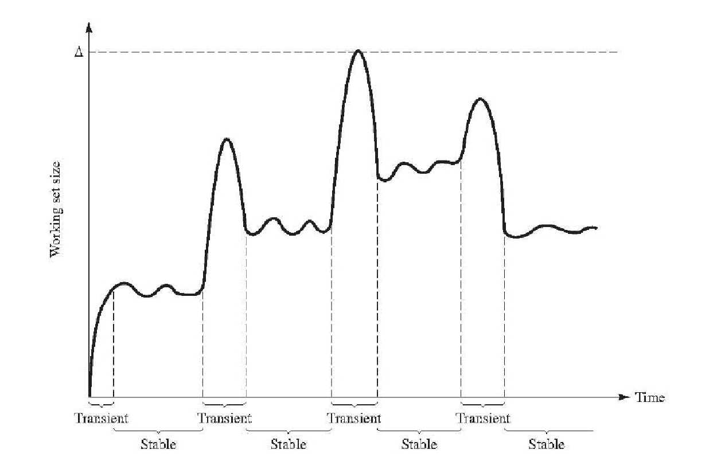
Working Set Size

Slide 49
Working Set Discussion
If entire working set is in memory, no page faults
If insufficient space for working set, thrashing may occur
Processes busy swapping pages in and out
Processes spending more time paging than executing
Idea
Keep the working set in memory to minimize the number of page faults

Slide 50
Working Set Based Page Replacement Algorithm (1)
A threshold T, and for every page saved
Time of last use
Reference bit R, and modified bit M (writeback check)
If reference bit R=0, page is a candidate for removal
Calculate age = (current time – time of last use)
If age > threshold, page is replaced
If age < threshold, still in working set, but may be removed if it is oldest page in working set
If R=1, set time of last use = current time, set R=0
Page was recently referenced, so in working set
If no page has R=0, choose the oldest (one that requires no writeback) – when all same age, pick randomly

Slide 51
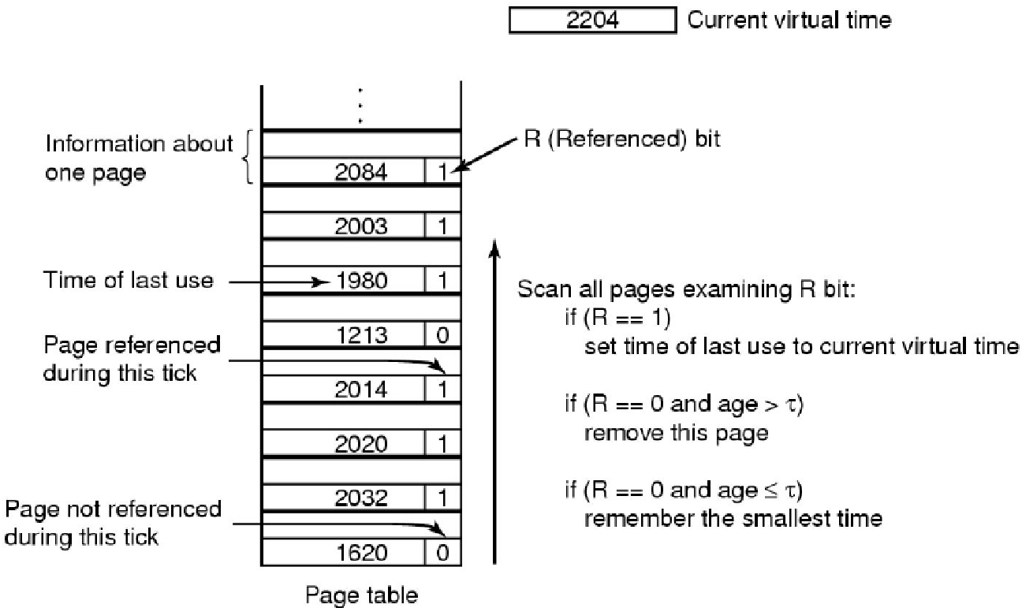
Working Set Based Page Replacement Algorithm (2)
The working set algorithm. (MOS Figure 3-19)
!!!!! Please note that page table CANNOT save times

Slide 52
Working Set Clock (WSClock) Algorithm
Motivation
The basic working set algorithm needs to scan the entire page table, which is expensive!
Use circular list of page frames (including R and M)
If R=0 and age > threshold
Page is clean (M=0), replace
Page is dirty (M=1), schedule write but advance hand to check other pages
If R=1, set R=0 and advance hand
At end of 1st pass, if no page has been replaced
If write has been scheduled, keep moving hand until write is done and page is clean. Evict 1st clean page
If no writes scheduled, claim any clean page even though it is in the working set

Slide 53
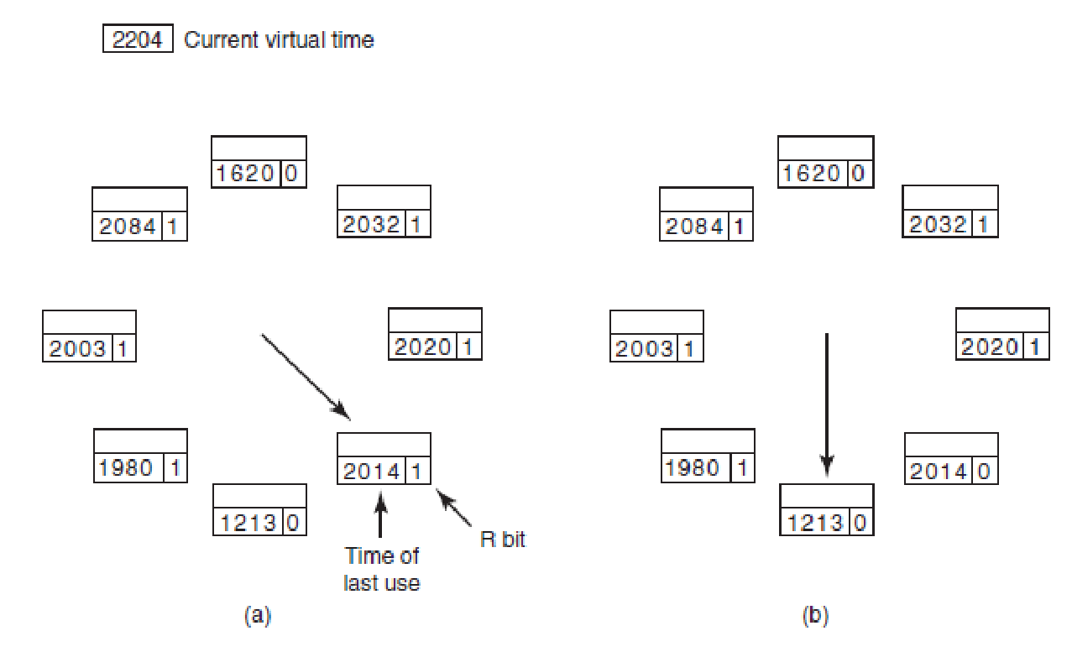
The WSClock Page Replacement Algorithm (1)
Operation of the WSClock algorithm. (a) and (b) give an example of what happens when R = 1(set R=0 and advance hand).

Slide 54
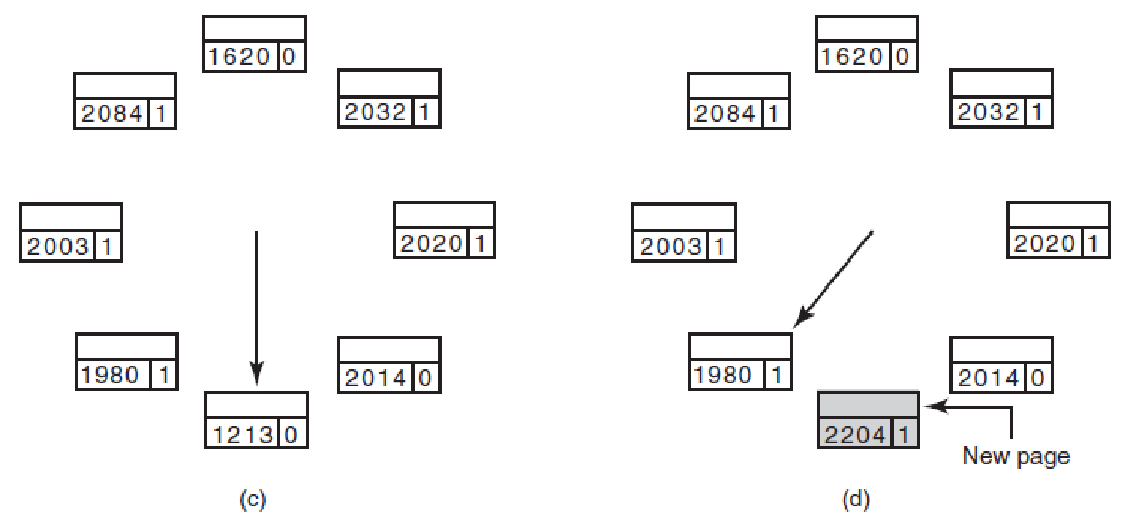
The WSClock Page Replacement Algorithm (2)
Operation of the WSClock algorithm. (c) and (d) give an example of R = 0 (Page is clean (M=0), replace)

Slide 55
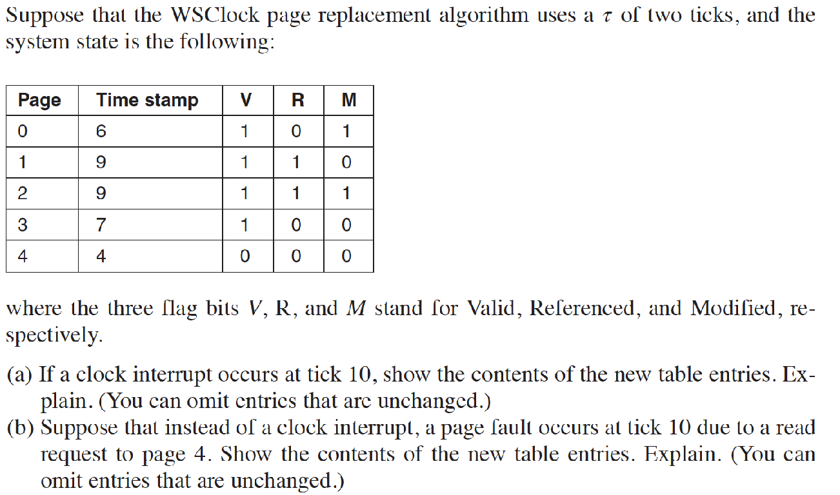
Question

Slide 56
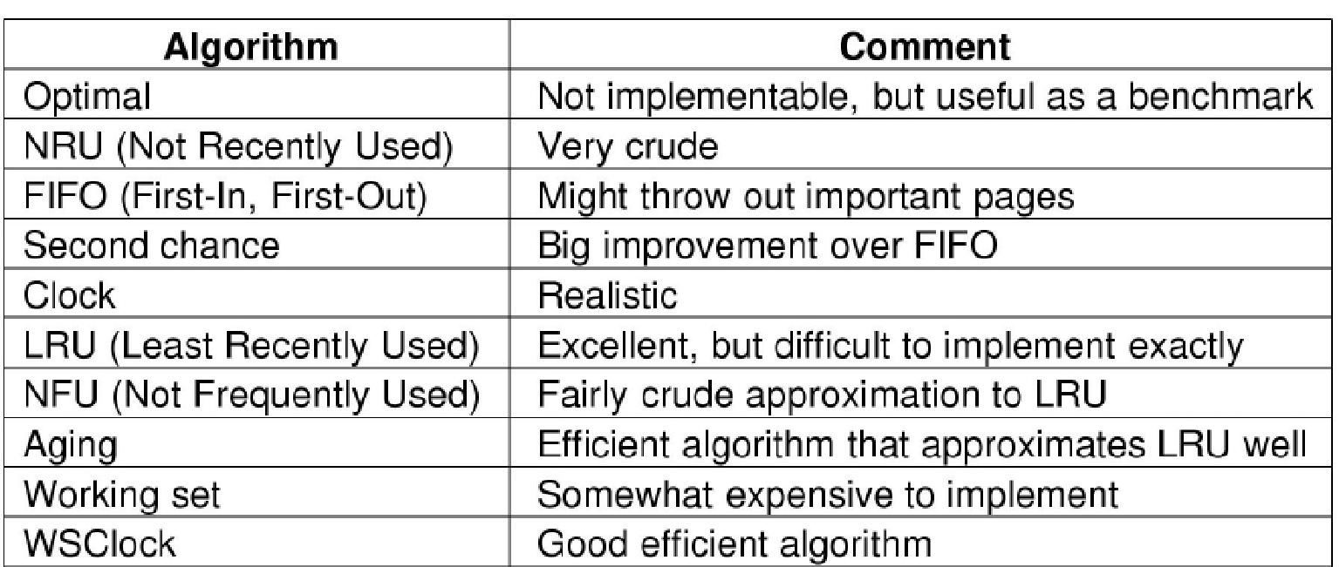
Review of Page Replacement Algorithms
Page replacement algorithms discussed in the text. (MOS Figure 3-21.)
Notes:
The optimal algorithm evicts the page that will be referenced furthest in the future.
Unfortunately, there is no way to determine which page this is, so in practice
this algorithm cannot be used. It is useful as a benchmark against which other algorithms
can be measured, however.
The NRU algorithm divides pages into four classes depending on the state of
the R and M bits. A random page from the lowest-numbered class is chosen. This
algorithm is easy to implement, but it is very crude. Better ones exist.
FIFO keeps track of the order in which pages were loaded into memory by
keeping them in a linked list. Removing the oldest page then becomes trivial, but
that page might still be in use, so FIFO is a bad choice.
Second chance is a modification to FIFO that checks if a page is in use before
removing it. If it is, the page is spared. This modification greatly improves the
performance. Clock is simply a different implementation of second chance. It has
the same performance properties, but takes a little less time to execute the algorithm.
LRU is an excellent algorithm, but it cannot be implemented without special
hardware. If this hardware is not available, it cannot be used. NFU is a crude attempt
to approximate LRU. It is not very good. However, aging is a much better
approximation to LRU and can be implemented efficiently. It is a good choice.
The last two algorithms use the working set. The working set algorithm gives
reasonable performance, but it is somewhat expensive to implement. WSClock is a
variant that not only gives good performance but is also efficient to implement.
All in all, the two best algorithms are aging and WSClock. They are based on
LRU and the working set, respectively. Both give good paging performance and
can be implemented efficiently. A few other good algorithms exist, but these two
are probably the most important in practice.

Slide 57
Page Frames Allocation to Processes

Slide 58
Allocation of Page Frames
Each process needs minimum number of page frames
Problem
how many page frames should be allocated to a process?
Two major allocation schemes
Fixed allocation
Priority allocation

Slide 59
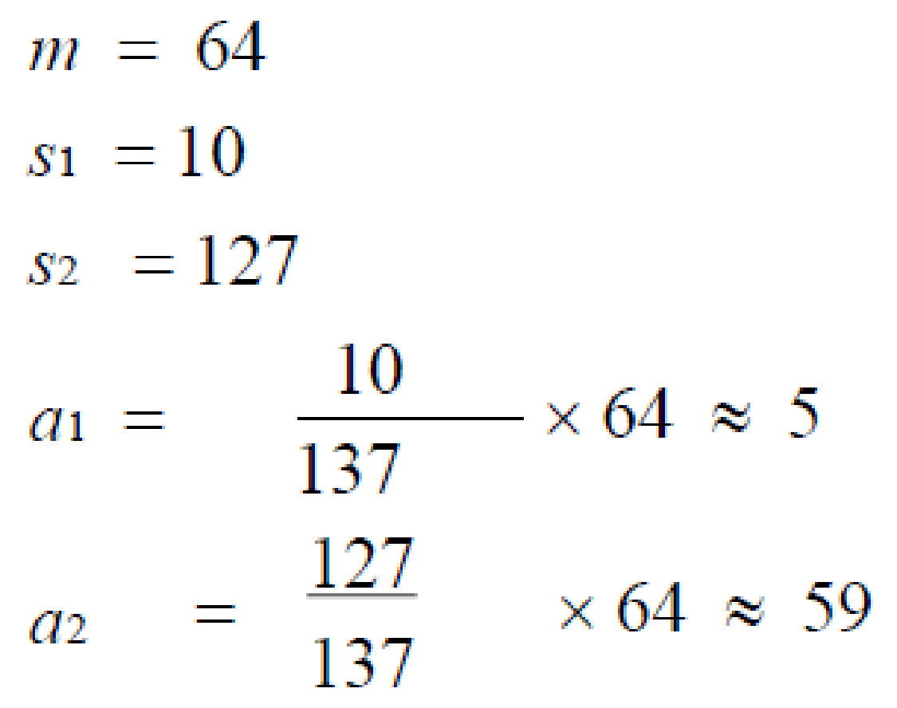
Fixed Allocation
Equal allocation
For example, 100 frames and 5 processes, give each process 20 frames
Proportional allocation
Allocate according to the size of process
s_{i} = size of process p_{i}
S = Σs_{i}
m = total number of frames
a_{i} = allocation for p_{i} = s_{i} / S * m
Example

Slide 60
Priority Allocation
Use a proportional allocation scheme that uses priorities rather than size
If process Pi generates a page fault
select from a process with lower priority number for page replacement

Slide 61
Global and Local Allocation
Local replacement
For each process the OS only selects from the process own set of allocated frames
Global replacement
For each process the OS selects a replacement frame from the set of all frames
one process can take a frame from another

Slide 62
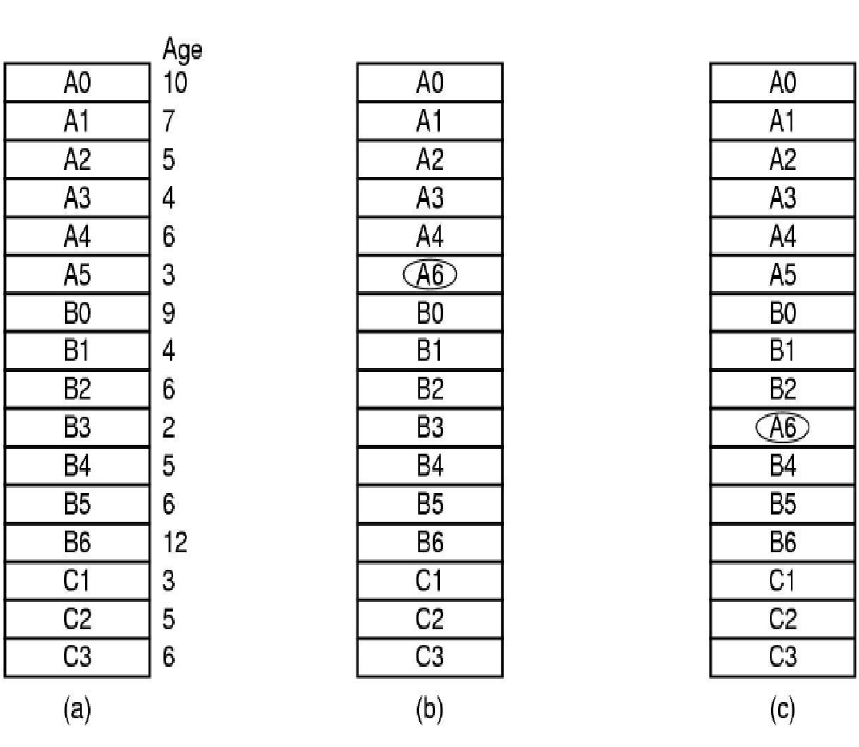
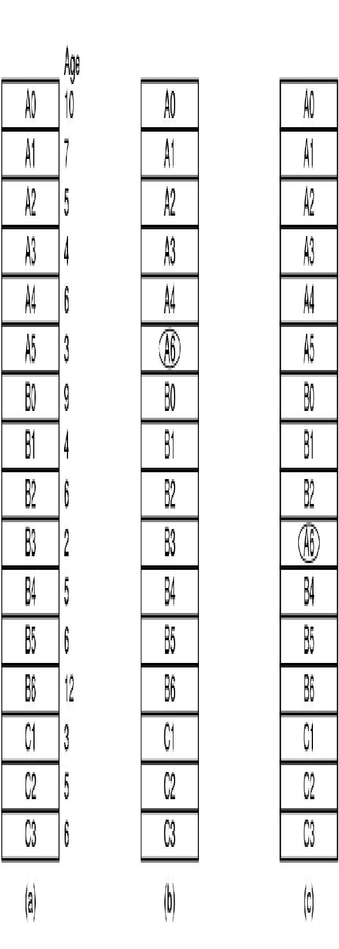
Global vs Local Allocation (1)
Process A needs a new page frame (aging algorithm)
Local Allocation
Global Allocation

Slide 63
Global vs Local Allocation (2)
Local replacement
Pros: when a process thrashes, it does not cause other processes to thrash
Cons: can lead to wasted memory if a process’ working set decreases in size
Global replacement
Pros: Better for dynamic working set which may grow or shrink
Cons: Domino-style thrashing may occur
Process A page faults, evicting process B’s pages, and when process B runs, it evicts process C’s pages, etc.

Slide 64
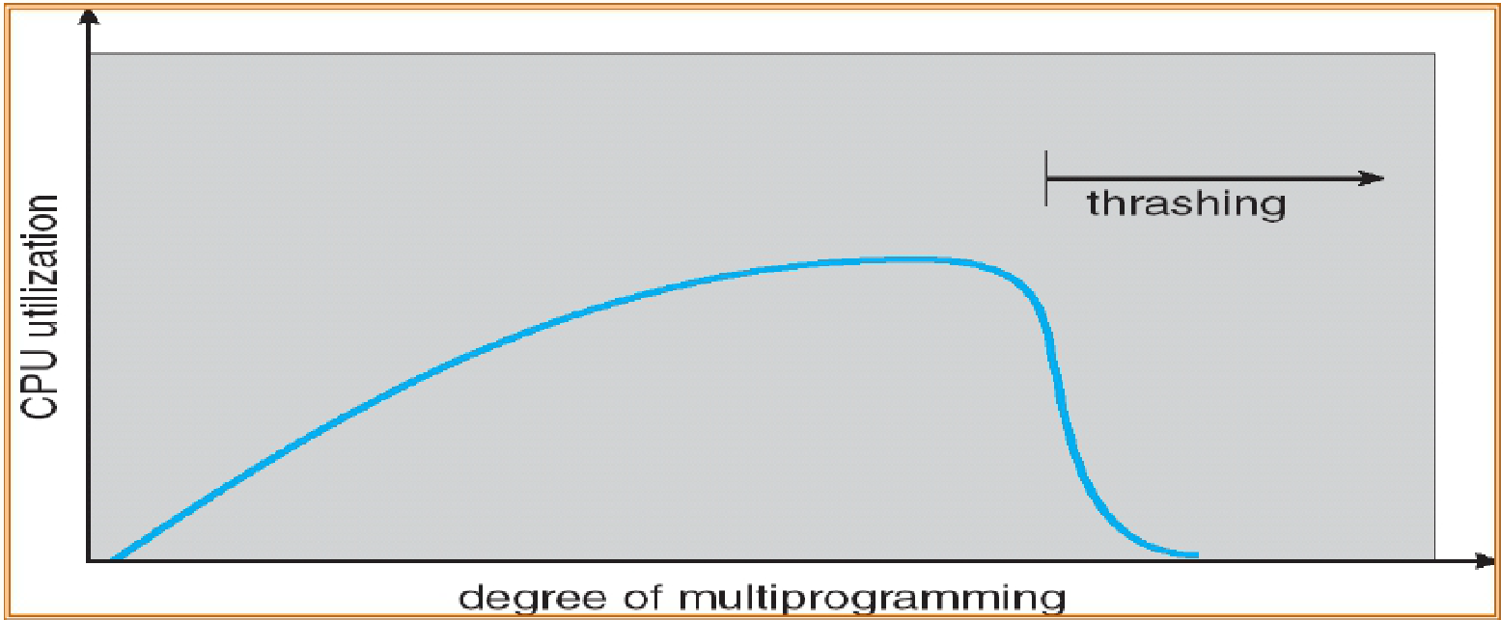
Thrashing
Processes busy swapping pages in and out, i.e., processes spending more time paging than executing
Processes’ CPU Utilization
Degree of multiprogramming

Slide 65
Policies to Prevent Thrashing
Adopt a local allocation policy
Do not schedule a process unless its working set of pages is in memory (implies prepaging)
Use Page Fault Frequency approach

Slide 66
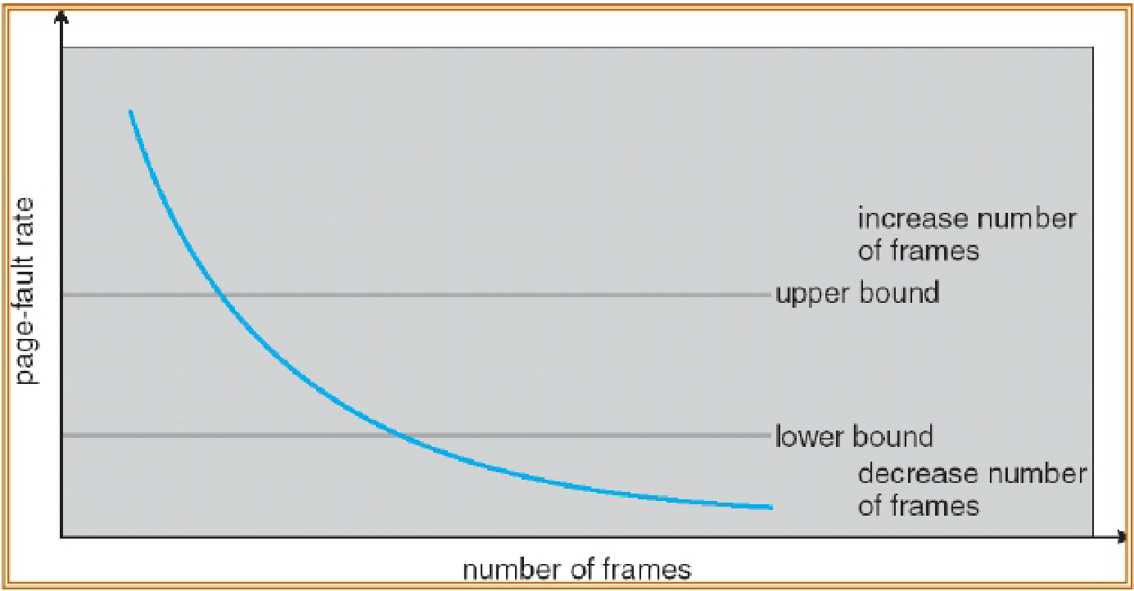
Page Fault Frequency Scheme (1)
Measure of page fault rate of a process
Too low – take pages from that process
Too high – allocate additional page frames to the process

Slide 67
Page Fault Frequency Scheme (2)
If many processes have high page fault frequency, swap out one or more of these processes
Which process to swap out is determined by scheduling algorithm
May also use process priority to affect page allocation (thereby, affecting page replacement)

Slide 68
Relationship of Allocation to Replacement Policy
FIFO and LRU can be run either globally or locally on the process’ pages
Working set makes sense only as a local policy or to initialize the number of pages given to a process

Slide 69
Question
A computer whose processes have 1024 pages in their address spaces keeps its page tables in memory. The overhead required for reading a word from the page table is 5 nsec. To reduce this overhead, the computer has a TLB, which holds 32 (virtual page, physical page frame) pairs, and can do a lookup in 1 nsec. What hit rate is needed to reduce the mean overhead to 2 nsec?

Slide 70
Question
If FIFO page replacement is used with four page frames and eight pages, how many page faults will occur with the reference string 0172327103 if the four frames are initially empty? Now repeat this problem for LRU.

